Slide 1
CSCI 8360 – Project 2 Cilia Segmentation Team linden Abolfazl Farahani, Jonathan Myers, and Jiahao Xu

Slide 2
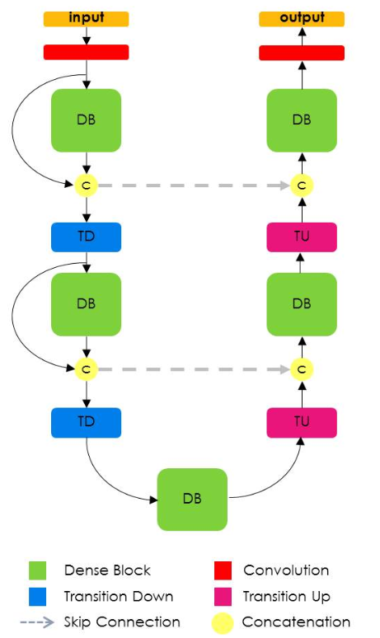
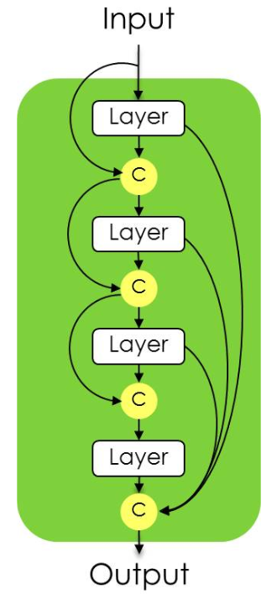
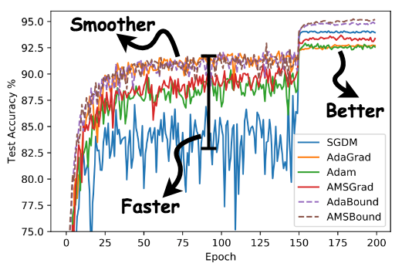
Models
Optical Flow
Variance
Tiramisu Convolutional Neural Network
(https://arxiv.org/pdf/1611.09326.pdf)
Brendan Fortuner (https://github.com/bfortuner/pytorch_tiramisuSecond)
AdaBound (https://github.com/Luolc/AdaBound)
Best Accuracy for each model
Tiramisu: 40.6%
Optical Flow: 22.2%
Variance: 1%

Slide 3
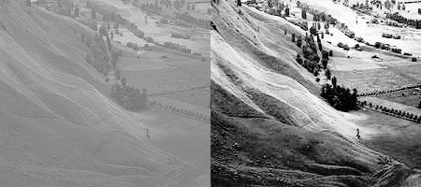

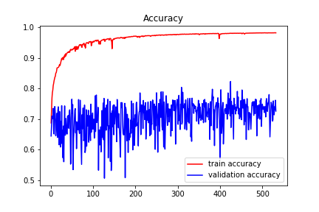
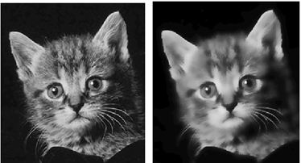
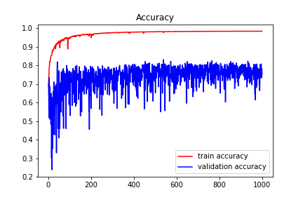
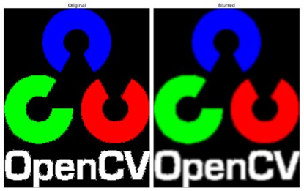
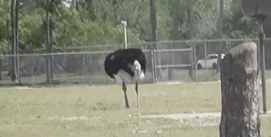
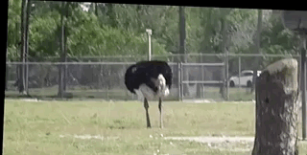
Preprocessing
Tiramisu
Confidence
Grew
OpenCV
(https://docs.opencv.org/3.4/index.html)
Clahe: Equalizer
Bilateral Filter: Soothing
Gaussian Blur: Remove Noise
Video Stabilizing: Remove camera shake

Slide 4
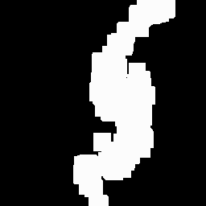

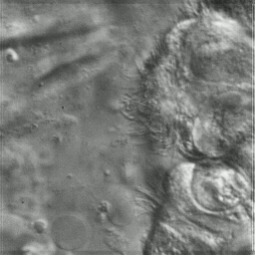
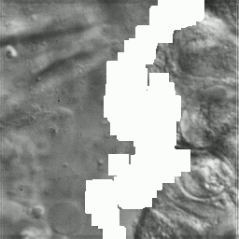
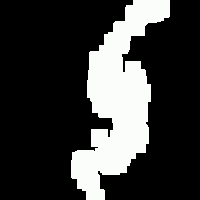
Future work
Using object motion detection techniques
Focusing on the area of interest
cropping the image based on existence of Cilia
Feeding the new input to the segmentation model.
Predicted Mask
Ground truth
Motion detection algorithm
Find contours around the object of interest
Finding threshold

Slide 5
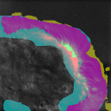
Questions?

